Slide 1
Aboriginal and TSI Separating Techniques
Describe separation techniques used by Indigenous people, such as:
hand picking
sieving
winnowing
yandying
filtering
cold pressing
steam distilling
Describe the types of mixtures that can be separated using the above techniques
Explain how the above techniques separate mixtures
Compare the above techniques to the ones studied in class

Slide 2
Homework – Due Wednesday
Choose one of the Aboriginal and TSI separating techniques
Create an A4 poster (paper or electronic) or a one slide PowerPoint presentation
Answer questions 1-4
Include illustrations and examples
Write in your diary
Look for this powerpoint on Connect

Slide 3
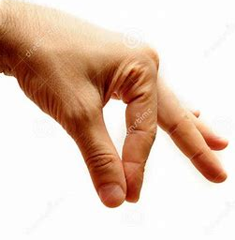
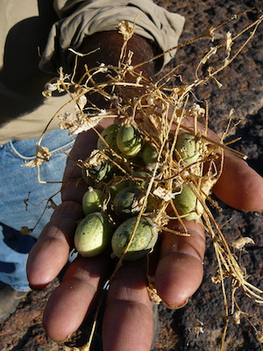
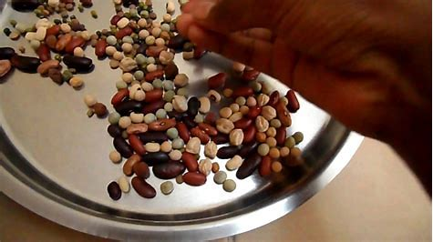
Example: Hand Picking
This indigenous separating technique separates a mixture simply by someone picking out one object at a time using the hands.
It can be used to separate out dry mixtures of things that look or feel different to one another. For example the native cucumber (top right) can be hand picked out of the dry sticks.
The part of the mixture that the aboriginal people want to keep is picked up by hand and put into another container.
This is different to the separating techniques studied in class because it does not use a machine or equipment. It is similar to filtering because it separates a mixture depending on its size.

